Slide 1
INTRODUCTION, AIM AND OBJECTIVES
Basic definitions
Concepts

Slide 2
Topics to be discussed are:
1. TRANSMISSION OF POWER
MACHINE TOOLS
CASTING
FORGING
WELDING

Slide 3
TRANSMISSION OF POWER

Slide 4
Definition and importance
Power: Energy to do the work, Rate of doing work
Types of Power: Electrical, Heat, Mechanical,
Importance of power:
Importance of power transmission:
Transmission system
The rotational motion can be transmitted from one mechanical element to the other with the help of certain systems known as transmission system.

Slide 5
Transmission Systems
Employed to drive a device directly from by a prime mover or
To transmit the rotational motion to the various parts of machine within itself.
Usually round rods, called shafts are used to transmit the rotational motion
Shaft that drives- driving shaft
Power receiving shaft - driven shaft.

Slide 6
The methods of power transmission (Classification)
Based on distance between driving and driven shafts, speed and amount of power, systems are classified as
Belt drive
Chain drive.
Rope drive.
Gear drive.

Slide 7
Belt drive
One of the common method employed whenever power or rotary motion is to be transmitted between two parallel shafts.
Consists of two pulleys over which an end less belt is running encircling both of them.
Power or motion is transmitted from the driving pulley to driven pulley because of the frictional grip exists between the belt and the pulley surface.
The portion of the belt which is having less tension is called slack side and the one which has higher tension is called tight side.
Because of difference in tensions the power is transmitted.

Slide 8
Belt drives
Two types:
Open belt drive
Cross belt drive

Slide 9
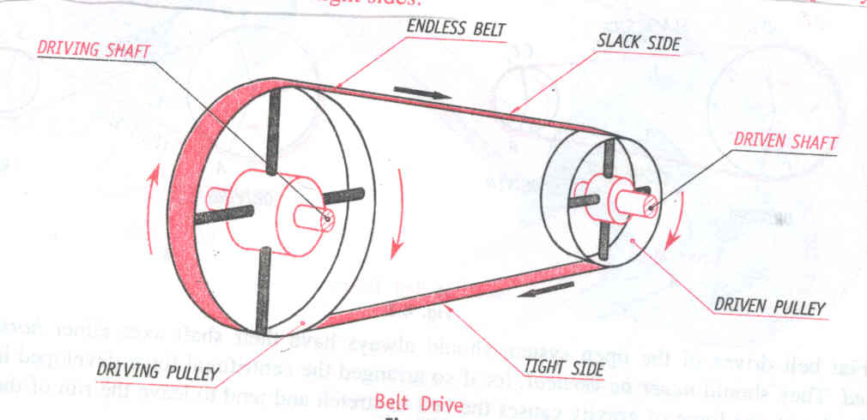
Open belt drive: Employed when two shafts are to be rotated in the same direction.

Slide 10
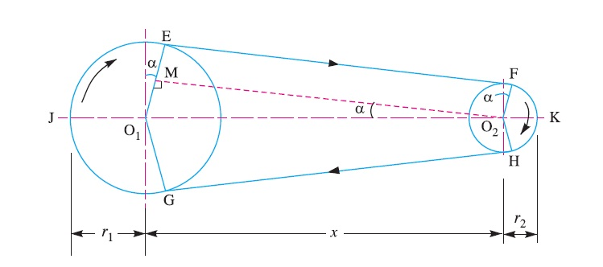

Slide 11
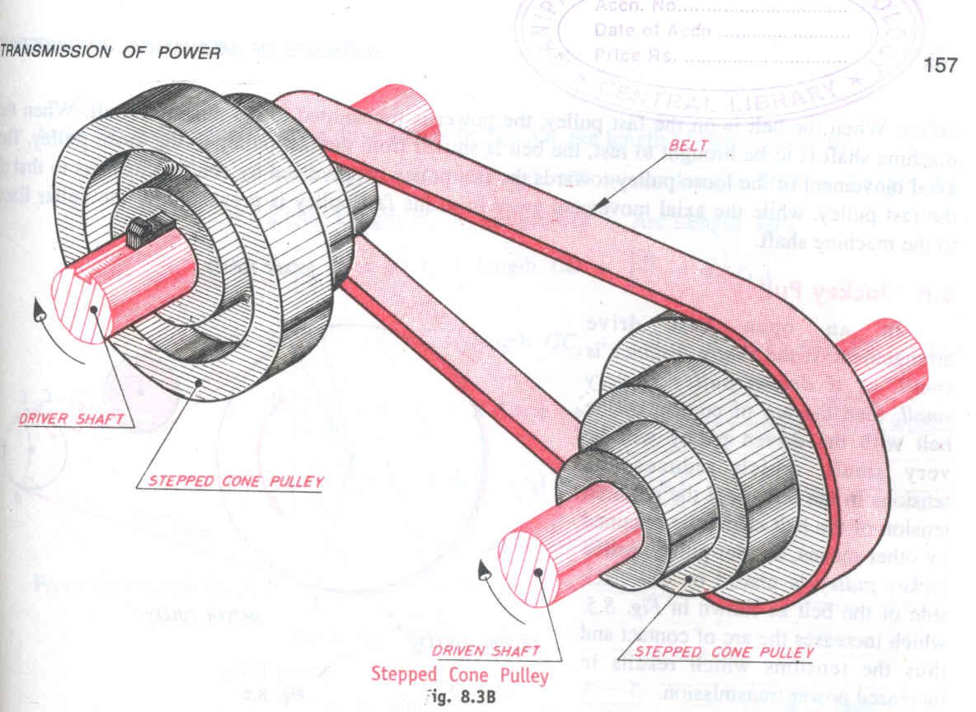
Open belt drive with stepped cone pulleys

Slide 12
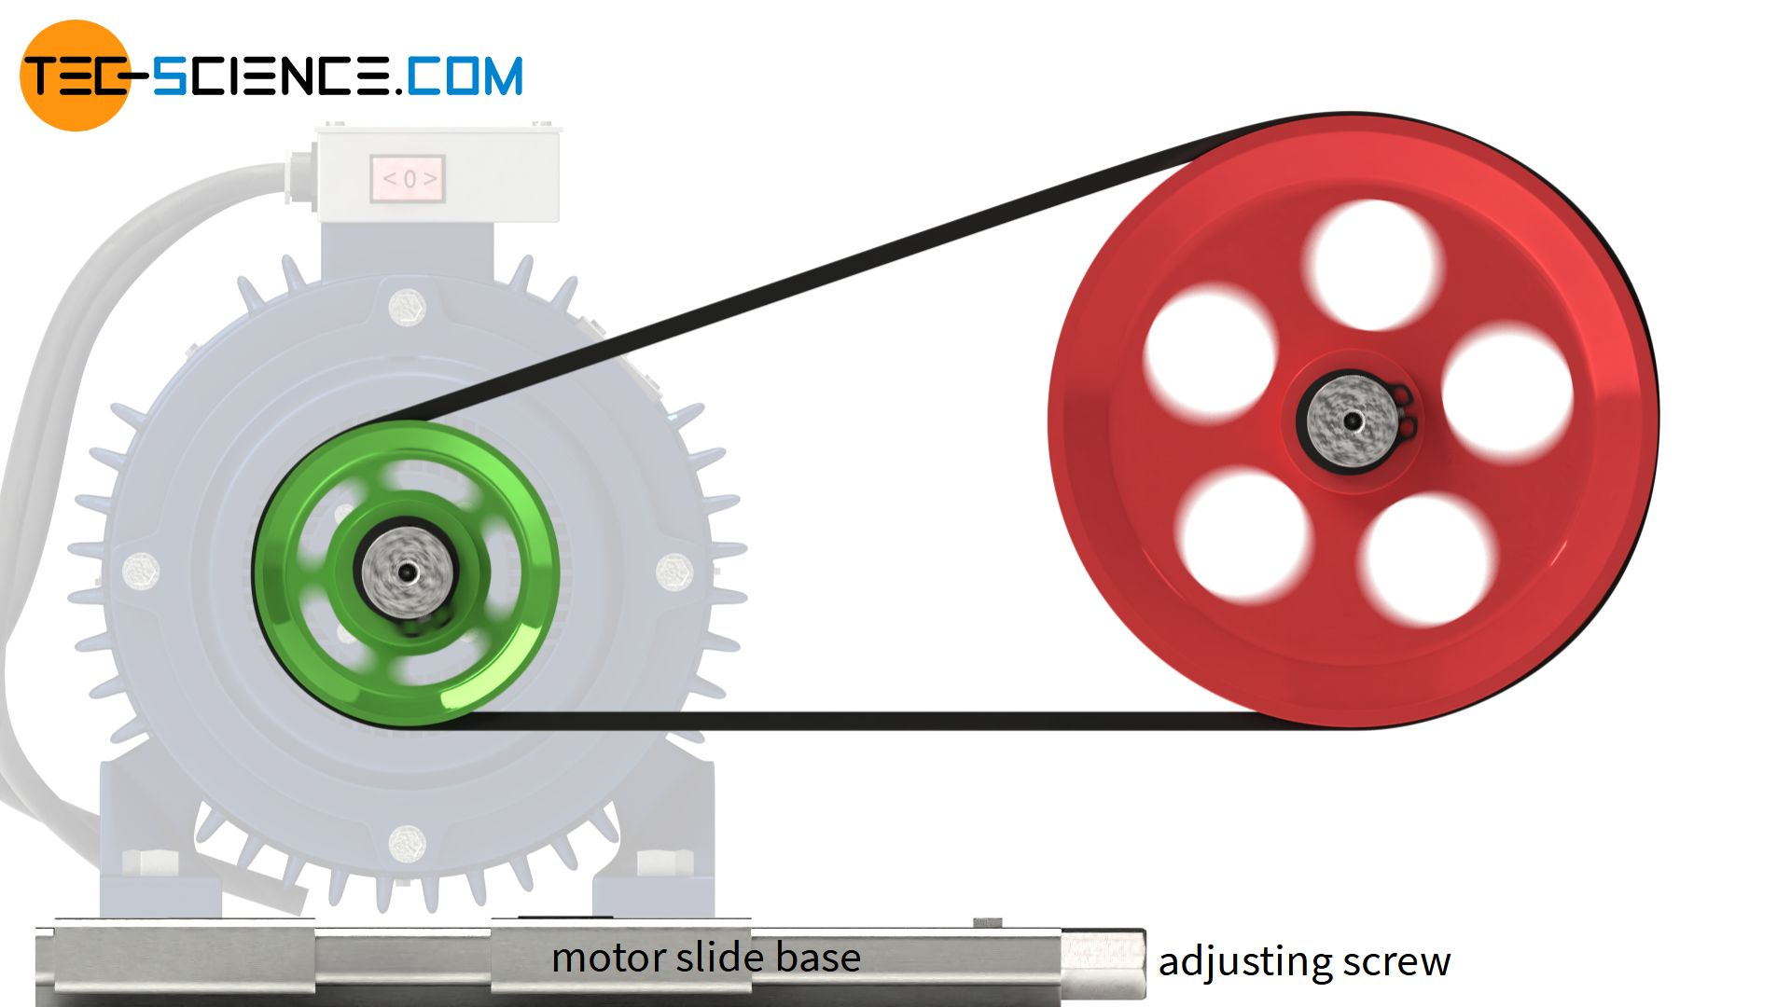

Slide 13
Open belt drives
When the shafts are placed far apart, the lower side of the belt should be the tight side and the upper side must be the slack side.
When the upper side becomes the slack side, it will sag due to its own weight and thus increases the arc of contact.

Slide 14
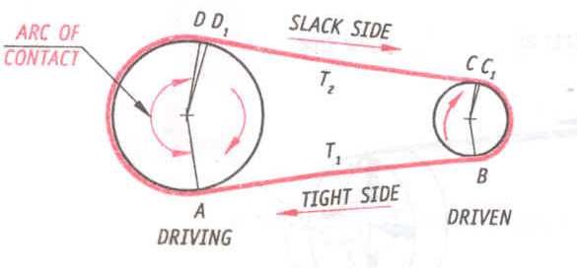
Open belt drive

Slide 15
Flat belt drives of the open system should always have:
Their shaft axes either horizontal or inclined.
They should never be vertical

Slide 16
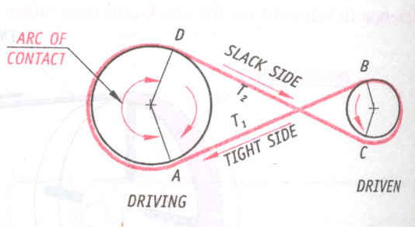
Crossed belt drive

Slide 17
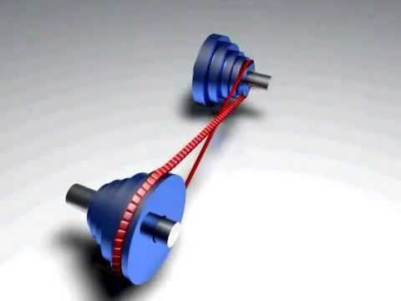

Slide 18
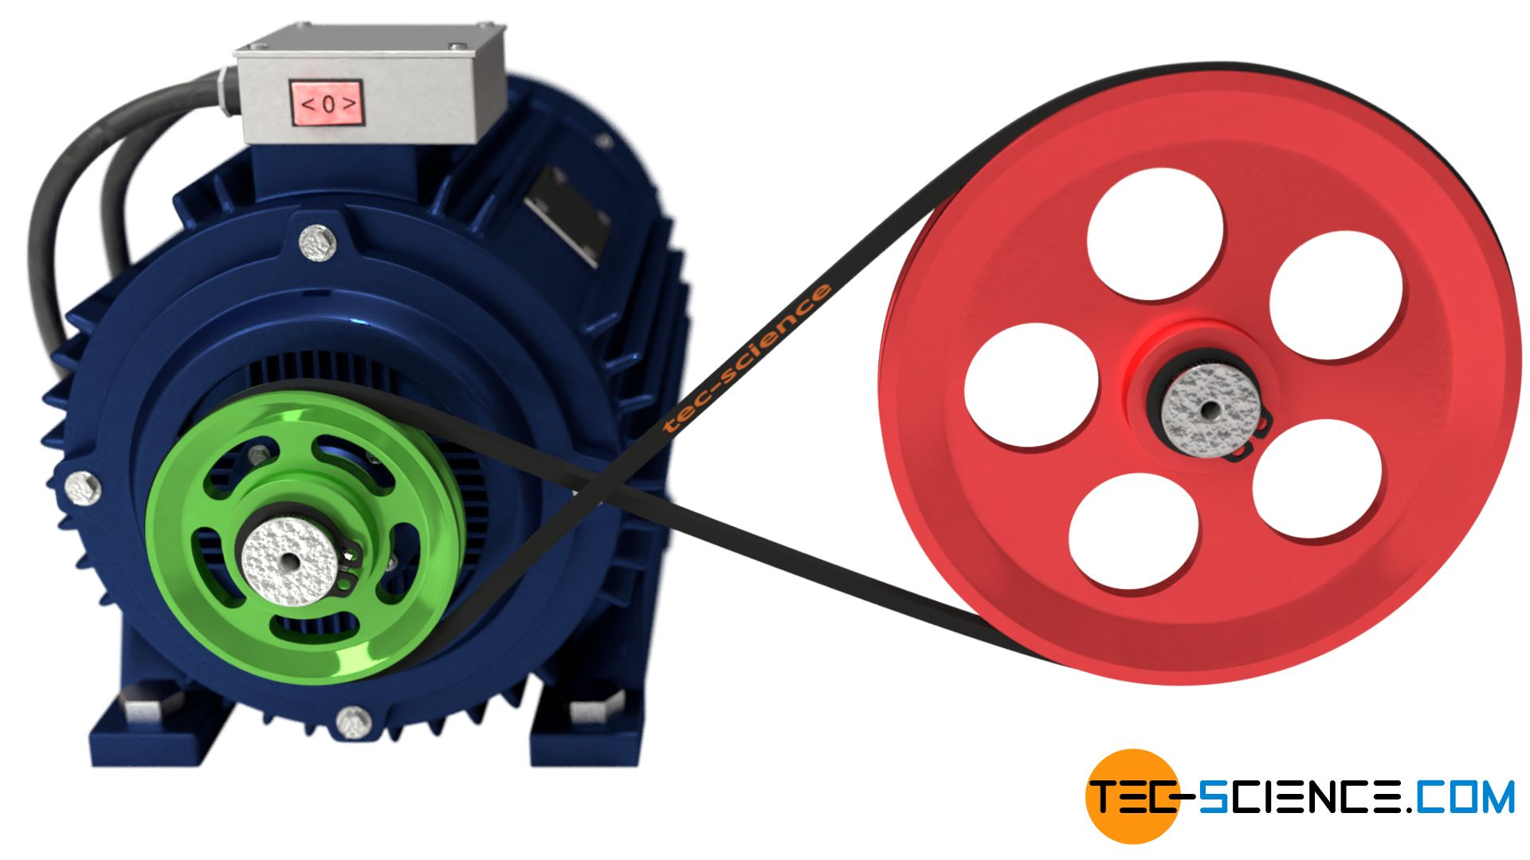

Slide 19
CROSSED BELT DRIVE
Used when two parallel shafts have to rotate in the opposite direction.
At the junction where the belt crosses, it rubs against itself and wears off.
To avoid excessive wear:
The shafts must be placed at a maximum distance from each other
Should operate at very low speeds.

Slide 20
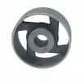
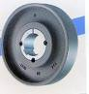
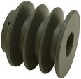
Pulley
Pulleys are used to transmit power from one shaft to the other at a moderate distance away by means of a belt or rope running over them.

Slide 21
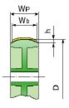
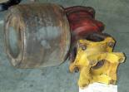
Crowning in a pulley
When the flat belt on cylindrical pulley is off-center and the pulley rotating, the belt quickly moves up to the largest radius at the top of the crown and stays there.
Crowning: Keeping of the diameter of the pulley little bit higher at centre compare to the edges.
The crowning is important to keep the belt "tracking" stable, preventing the belt from "walking off" the edge of the pulley.

Slide 22
A crowned pulley eliminates the need for pulley flanges and belt guide rollers.
When a flat belt runs over two pulleys, only one of them needs to be crowned to achieve lateral stability.
The amount of curvature required in actual machinery is small.
The method works for belts of leather or rubberized fabric that have some elasticity.

Slide 23
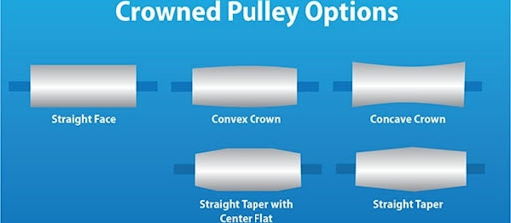

Slide 24
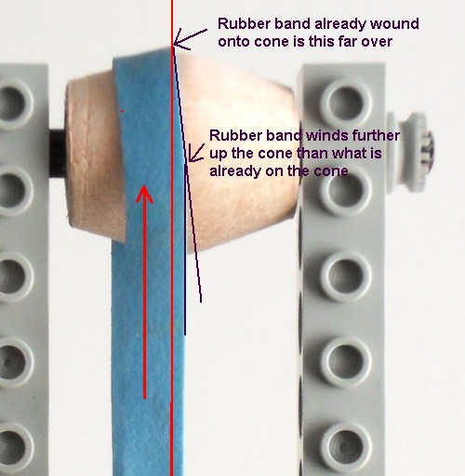

Slide 25
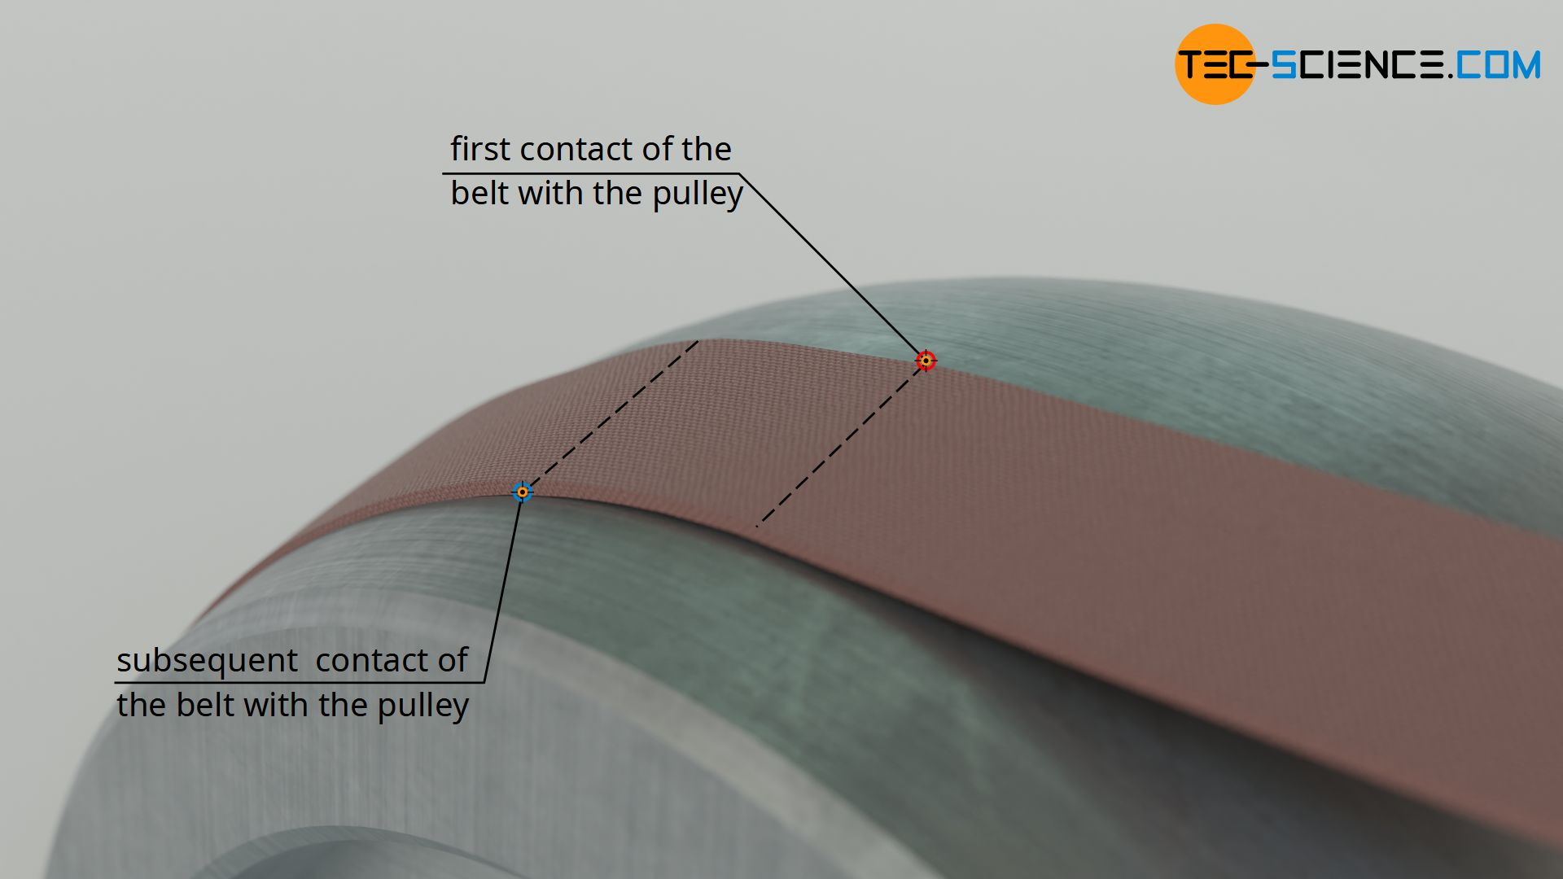

Slide 26
Merits and de-merits of Crowing
Crowning of pulleys provides an automatic correction to mis-tracking caused by transient forces that are applied to the belt.
Without crowning these transient forces cause the belt to be displaced without consistent means of returning to its normal path.
The de-merit is that, this can cause the belt edge cupping and wear.
For this reason it is wise to select a belt system with pulley crowning.

Slide 27
Pulley crowning
Critical dimensions:
Crowning of pulleys should not exceed 25mm on the dia. / meter of width
Width of the pulley should be 1/4th greater than width of the belt
Min. dia. of the belt should be at least 25 times thickness of the belt used to run the pulley

Slide 28
Types of pulleys
Stepped cone pulley (Speed cone)
Fast and loose pulleys
Guide pulley (Right angled drive)
Jockey pulley
Grooved pulley
Wrought-iron pulley

Slide 29
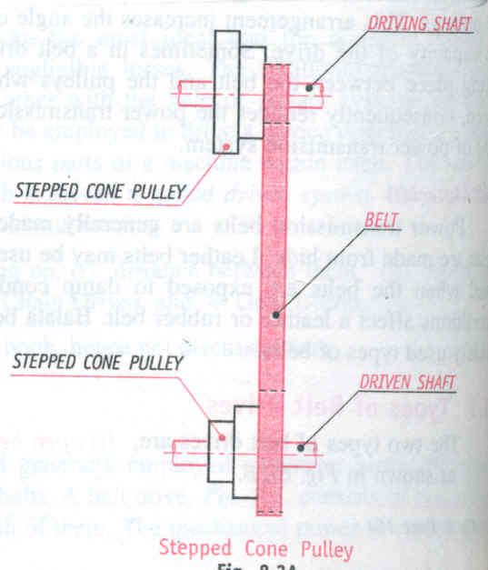
Stepped cone pulley
f

Slide 31
Stepped cone pulley
When speed of the driven shaft is to be changed very frequently
Used in lathe, drilling m/c etc..
Integral casting
One set of stepped cone pulley mounted in reverse on the driven shaft

Slide 32
Fast and Loose pulley
When many machines obtain the drive from one main driving shaft,
Stop and start some machines intermittently without stopping the main driving shaft
Fast pulley
Securely keyed to the machine shaft
Loose pulley (with brass bush)
Mounted freely on the machine shaft
Rotates freely

Slide 33
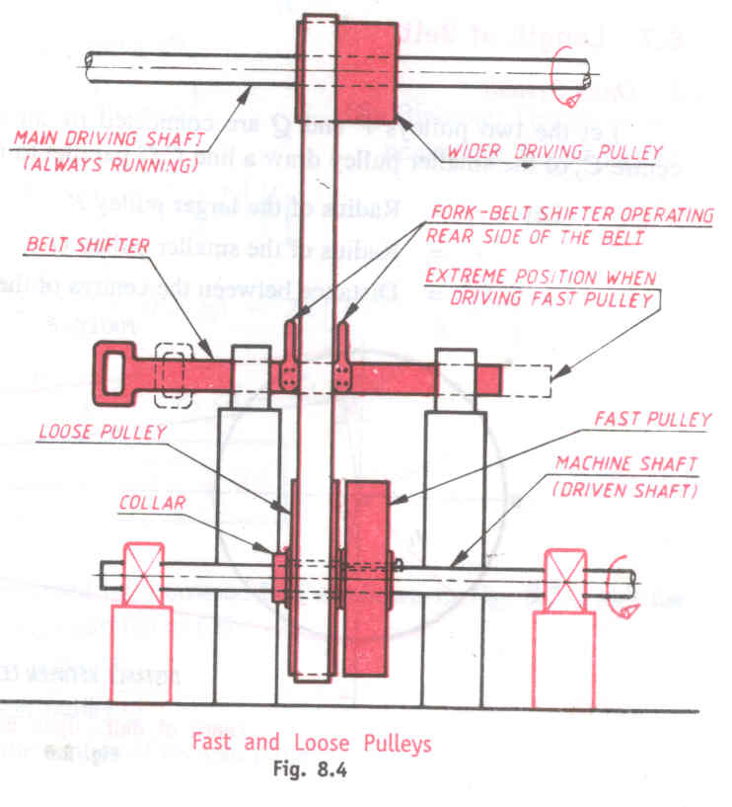
Fast and Loose pulley

Slide 34
Fast and Loose pulley
When many machines obtain the drive from a main driving shaft, it may be required to run some machines intermittently without having to Start and stop the main driving shaft
Fast pulley
Securely keyed to the machine shaft
Loose pulley (with brass bush)
Mounted freely on the machine shaft
Rotates freely

Slide 35
Working
When the belt is on the fast pulley,
Power transmitted to the machine shaft
When machine shaft is to be brought to rest,
Belt is shifted from fast pulley to loose pulley
Note:
Axial movement of the loose pulley towards fast pulley is prevented
Axial movement of the loose pulley away fast pulley is prevented

Slide 36
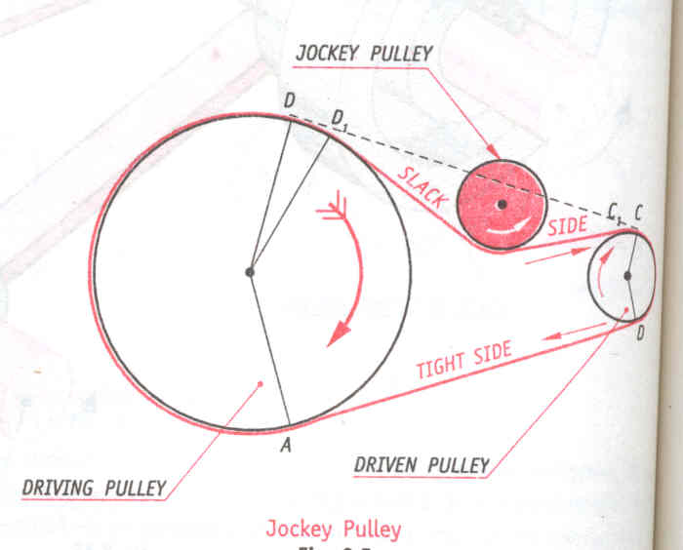
Jockey Pulley
k

Slide 37
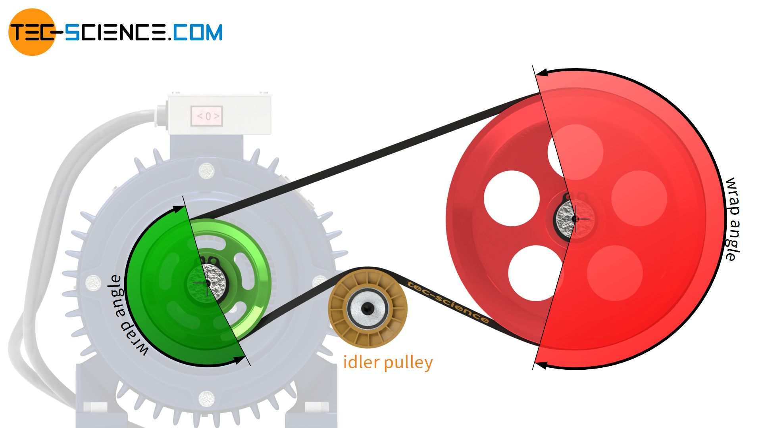

Slide 38
Jockey Pulley
When:
Center distance is small
One pulley is very small
Arc of contact small
Then,
Use idler pulley
Place on the slack side of the belt
Results:
Increase in arc of contact
Increase in tension
Increase in power transmission

Slide 39
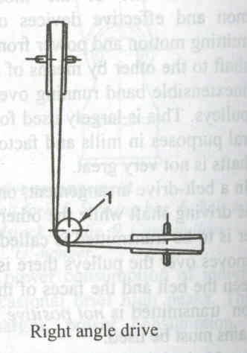
Guide pulley (Right angled drive)
Guide Pulley

Slide 40
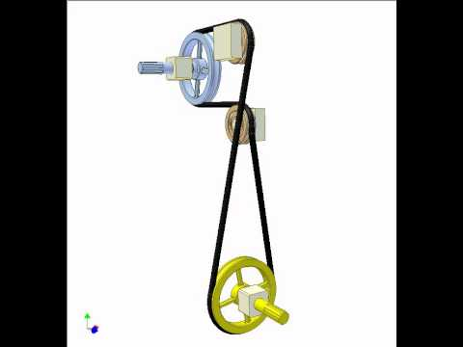

Slide 41
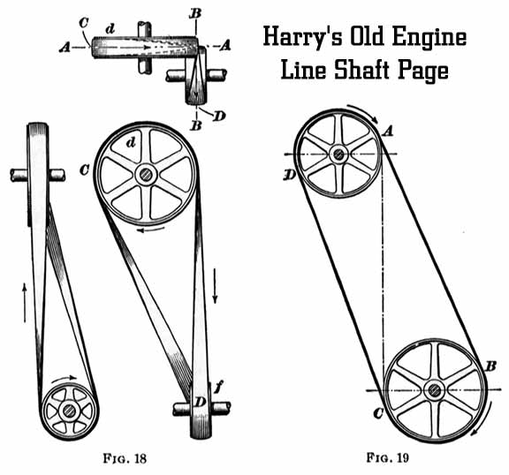

Slide 42
Guide pulley (Right angled drive)
Use:
To connect non-parallel shafts
To guide the belt in to the proper plane
When two shafts to be connected are close together
It is called, quarter turn drive.

Slide 43
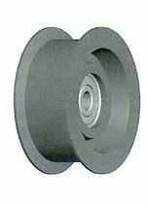
Grooved Pulley
The effect of groove is to increase the frictional grip of the rope on the pulley.
This reduces tendency to slip.
The groves are V-shaped.
Angle between 2 faces: 40⁰ – 60⁰
Uses:
Used in V-belts, rope.
Transmission of large powers over great distances

Slide 44
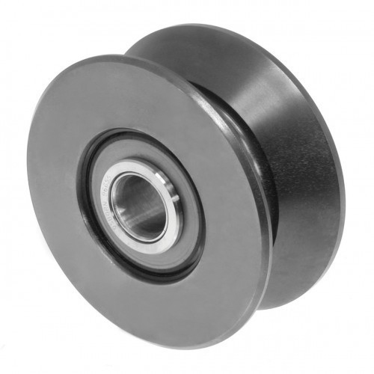

Slide 45
V-Belt Drive
Widely used form of belt drives in power transmission.
They are made out of rubber & fibrous material.
They run in the V-grooves made in the pulleys.
The wedging action of the belts in the V-grooves enable
them to transmit high torques.

Slide 46
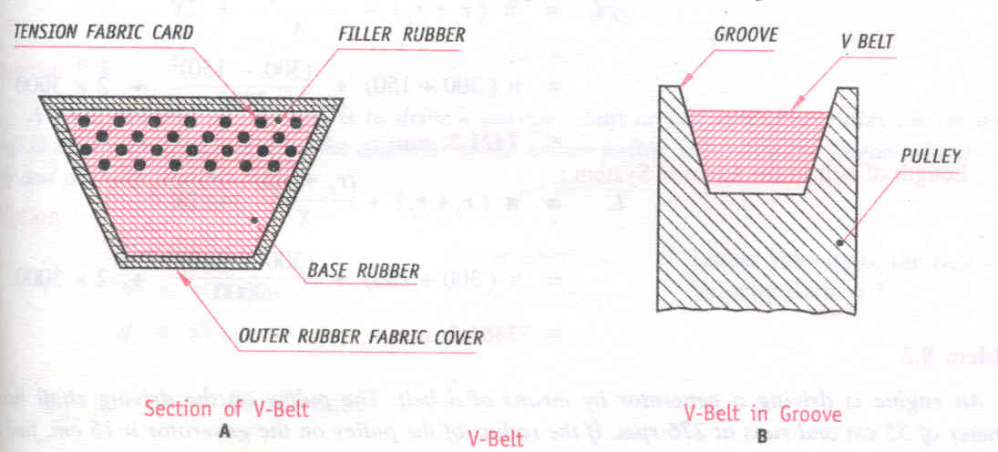
V-Belt Drive

Slide 47
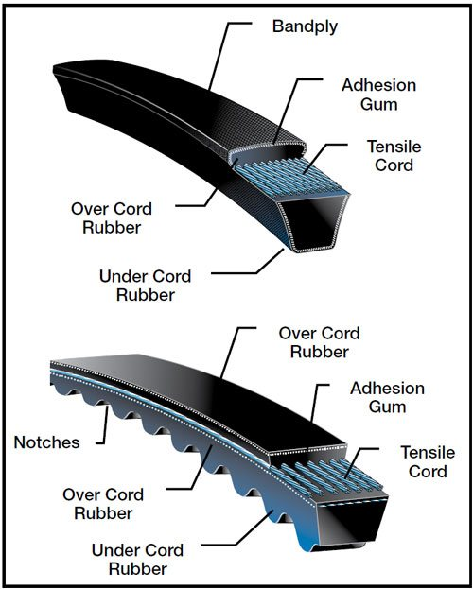

Slide 48
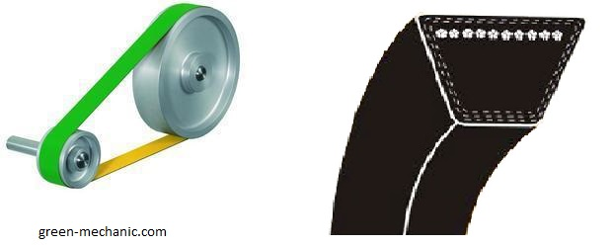

Slide 49
V-Belt Drive – Advantages over flat belt drive
Transmit greater power
Permit large speed ratios
No mis-tracking of the belt from the pulley
Maintenance is low

Slide 50
Length of a belt

Slide 51
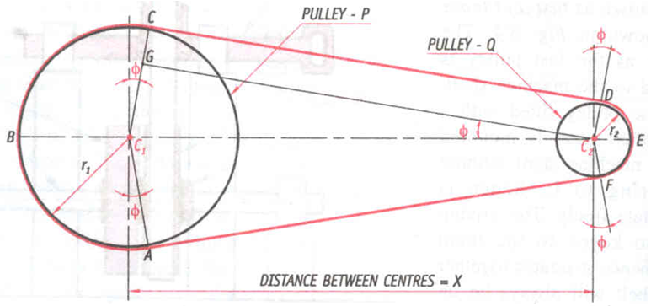
Length of a belt
Open belt drive:

Slide 52
Belt Length for OpenBelt
Let r₁=Radius of the Larger Pulley
r₂=Radius of the Smaller Pulley
X= distance between the Centre of the two pulley
L = Length of Belt

Slide 53
Length of a belt
Open belt drive:

Slide 54
From figure

Slide 55
From Δ^{le} GC₁C₂

Slide 57
Substituting equations 2 & 3 in equation 1:

Slide 58
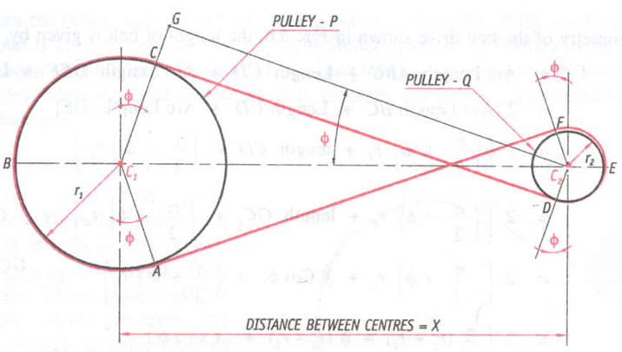
Length of a belt
Crossed belt drive:

Slide 59
Belt Length for Crossed Belt
Let r₁=Radius of the Larger Pulley
r₂=Radius of the Smaller Pulley
X= distance between the Centre of the two pulley
L = Length of Belt

Slide 60
From figure

Slide 61
From Δ^{le} GC₁C₂

Slide 63
Substituting equations 2 & 3 in equation 1:

Slide 64
Effect of sum of pulley diameter on the length of belt for open type
Any variation in which (r₁+ r₂) is kept constant will vary the length of the belt because of the term containing r₁- r₂
If speed cones are connected by an open belt, the belt will be slacker in some position than in others

Slide 65
Effect of sum of pulley diameter on the length of belt for crossed type
Here r1 and r2 only occur in the form of sum,
If sum is kept constant by varying r1 and r2, length of the belt will be constant
In speed cones:
They are connected by crossed belt, hence
Length of belt remains constant
Sum of diameters of the corresponding steps should be constant.

Slide 66
Velocity Ratio

Slide 67
Definition of Velocity Ratio for Belt Drives. (Speed Ratio)
The velocity ratio of a belt drive is defined as the ratio of the speed of the driven pulley to the speed of the driving pulley.

Slide 68
Expression for velocity ratio of belt drive.
If there is no relative slip between the pulley and the portions of the belt which are in contact with them, the speed at every point on the belt will be same.

Slide 69
The circumferential speeds of the driving and driven pulleys and the linear speed of the belt are equal.
Velocity Ratio
=
=

Slide 70
Effect of thickness of Belt on the Velocity Ratio
The velocity ratio derived holds good when the thickness of the belt is negligible.
But when the thickness of the belt is considerable, the circumferential speed should be the mean speed reckoned at the centre if the belt thickness.

Slide 71
If t= thickness of the belt,

Slide 72
Initial Tension in the belt
Initially the belt is wrapped over the two pulleys tightly.
Since the belt is made of elastic material, owing to its tight wrapping there always exists a uniform tension throughout the belt even when the drive is not functioning.
This uniform tension that exists initially when the drive is not in motion is called initial tension, (T_{o} ).

Slide 73
As soon as the driving pulley starts rotating, the tension in the belt increases from T_{o} to T₁ on the tight side and on the slack side it decreases from T_{o} to T₂ .
As there is no stretching of the belt when the drive is on, the increase in tension on the tight side must always be equal to the decrease in tension on the slack side, otherwise the belt will stretch.

Slide 75
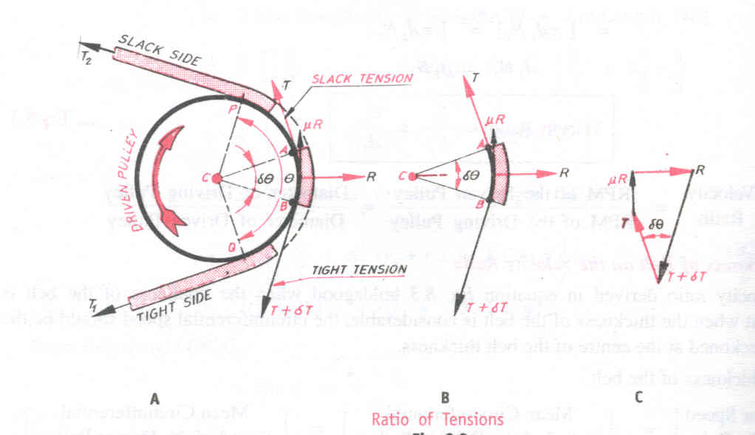
Expression for the ratio of tensions in belt drive.
The driving pulley drives the driven pulley only if one side
of the belt has higher tension than the other side.
The figure shows a driven pulley rotating in clockwise
direction.

Slide 76
The polygon of forces acting on the element is represented by
the closed quadrilateral as shown in figure.
Consider a small element AB of belt,
T₁= Higher tension,
T₂= Lower tension,
δθ = angle subtended by the element of AB
T =tension on the slack side of the belt.
μ = co­efficient of friction between the belt surface and pulley rim

Slide 77
Let the tension in the tight side of the belt element AB
be greater than the slack side by δT.
Therefore the tension in the tight side of the belt
element is T +δT.
If R is the normal reaction exerted by the pulley on the
element of the belt. Then,
The force of friction μR acts perpendicular to the
normal reaction R in the direction opposite to the
direction of motion as shown in figure.

Slide 78
Element AB will be in equilibrium only when
following forces act on it
Tension T on the slack side at A
Tension T +δT on the tight side at B
Normal reaction R
Frictional force μR acting perpendicular to R

Slide 79
Resolving all the forces in the direction of R.
R =
+
=
+
For small angles the following assumptions can be made.
Sin δθ/2 = δθ/2 & δT. δθ /2 is neglected.
R= 2T
R =T δθ ------------------------------ (1)

Slide 80
Resolving all the forces perpendicular to R
μR =
-
=
+
-
=
For small angles Cos δθ/2 = 1
μR = δT ---------------------- (2)
Substituting equation (1) in (2)
μT δθ = δT

Slide 81
Substituting equation (1) in (2)
μT δθ = δT
= μ δθ
Integrating δθ between 0 and θ and tension δT between T2 and T1
log _{e}
= μθ
= e ^{μ θ}
……3

Slide 82
Taking logarithms of equation 3
……… 4
Where, e = Base of Napierian logarithms
= 2.718
……… 5

Slide 83
Slip in Belt Drives

Slide 84
Slip in Belt Drives
The eqn δT = µR means that the difference between the tensions in the tight and slack sides is equal to the force of friction.
When this condition exists in a belt drive, the friction between the pulley and the belt in contact with it will provide the necessary frictional grip to prevent the sliding of the belt over the pulley.
Suppose the difference between the tensions in the tight and slack sides of the belt is greater than the force of friction, i.e. δT > µR , then the belt begins to slide over the surface of the pulley. This sliding of the belt which causes a relative motion between the pulley and belt is called slip.

Slide 85
Slip in Belt Drives
Slip mainly occurs when the differences between tensions in the tight and slack sides is very large, or when the coefficient of friction between the belt and pulley decreases owing to the stretch of the belt, or when the smoothness of the pulley surface is more.

Slide 86
Effect of slip on the Velocity Ratio
The slip is expressed as the percentage of speed.
Let,
S₁ = percentage of slip between the driving pulley and the belt.
S₂ = percentage of slip between the driven pulley and the belt.

Slide 87
Considering the percentage slip S₁ between the driving pulley and the belt passing over it
The circumferential speed of the belt on the driven pulley when slip S₂ occurs between the belt and its rim is given by

Slide 89
If the thickness of the belt is taken into consideration

Slide 90
Creep in Flat belt drive
The phenomena of alternate stretching and contraction of the belt results in a relative motion between the belt and the pulley surface.
This relative motion is called creep.

Slide 91
Creep in Flat belt drive
This results in:
Loss of power
Decrease in the velocity ratio

Slide 92
Power transmitted by a Belt drive
The driven pulley rotates because of the difference in tensions in the tight and slack sides of the belt.
Therefore, the force causing the rotation is the difference between the two tensions.
If v is the velocity of the belt m/min and T₁ and T₂ are the tensions on the tight and slack sides of the belts expressed in Newton, then

Slide 94
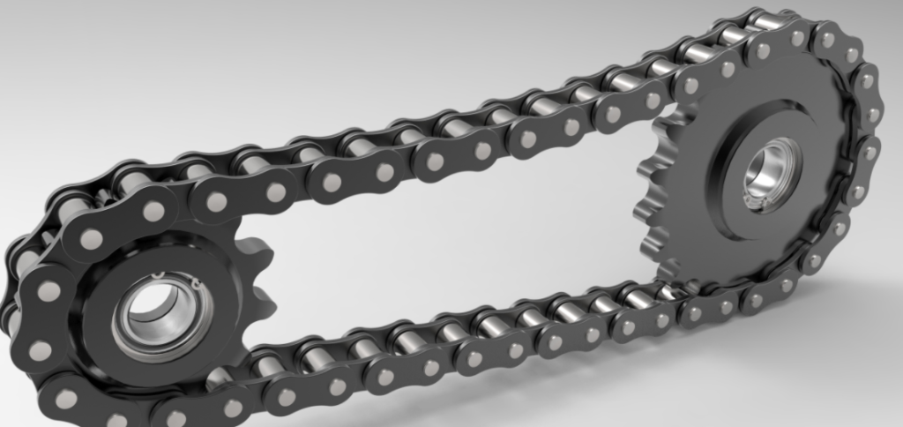
Chain Drives

Slide 95
Chain Drives
Over comes the disadvantages of the belt drive
Can be used up to 8m centre distances
Used in agricultural machinery, bicycles, motor cycles etc.
Two types of chains used in power transmission:
Roller Chain
Silent Chain

Slide 96
Roller Chain
A chain drive consisting of a chain and two sprockets
Widely used in low or medium speed power transmission systems
This type of chain is employed in bicycles, motorcycles, machine tools etc..

Slide 97
Silent Chain (Inverted Tooth Chain)
Consists of a series of toothed plates pinned together in rows across the width of the chain
Advantage:
- Smooth and noiseless operation at high velocities

Slide 98
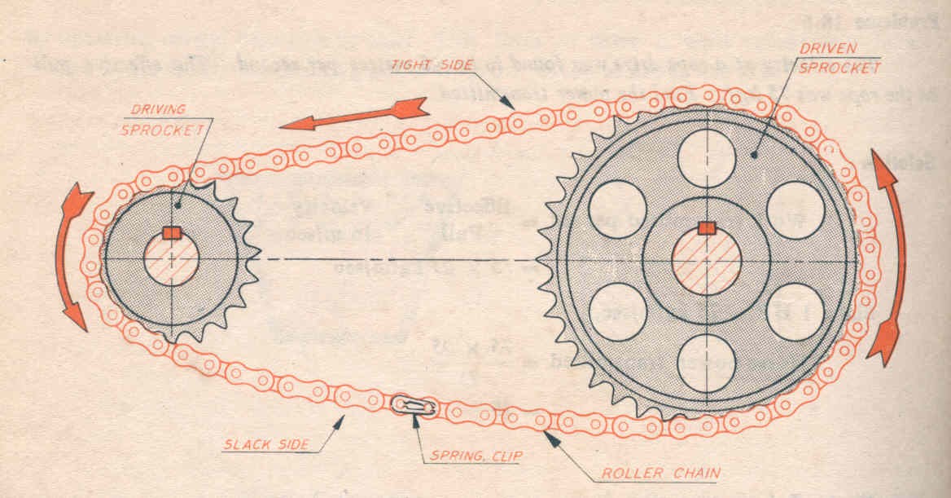
Chain Drive

Slide 99
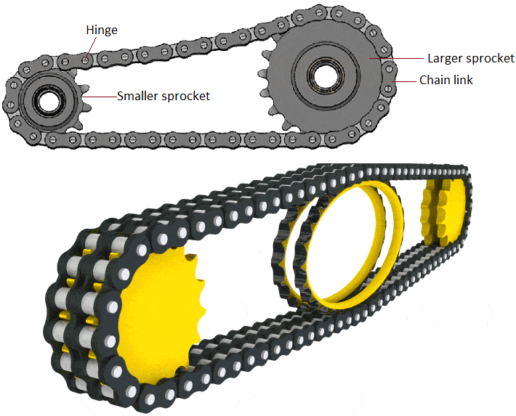

Slide 100
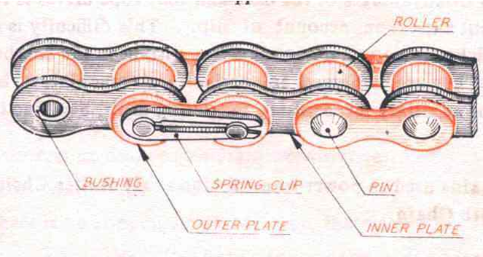
Roller Chain

Slide 101
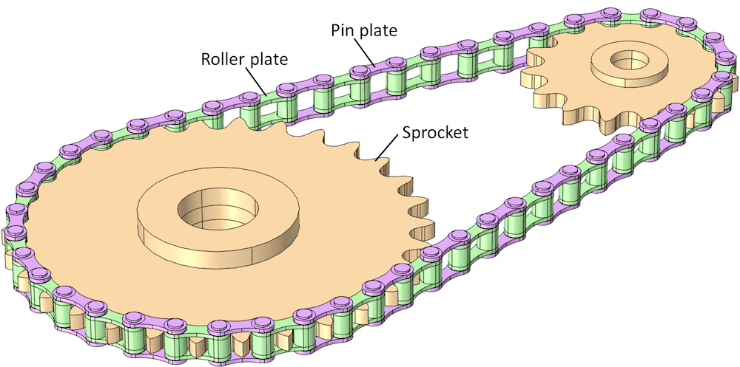

Slide 102
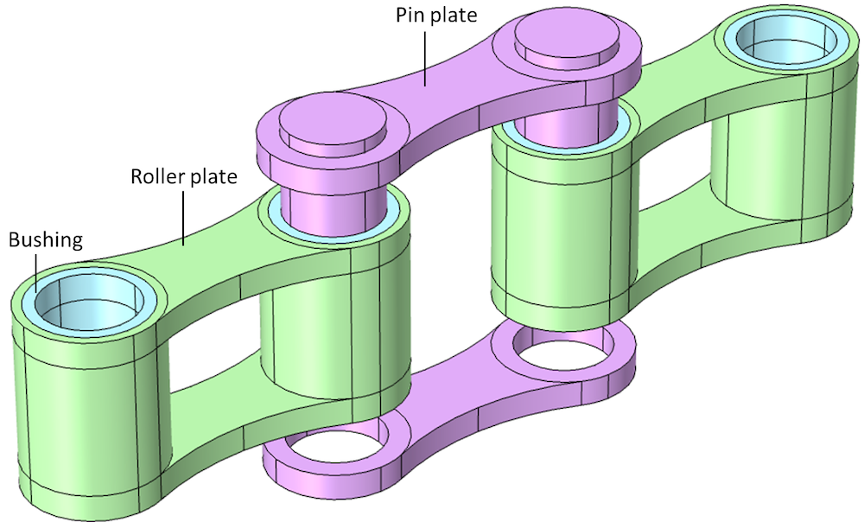

Slide 103
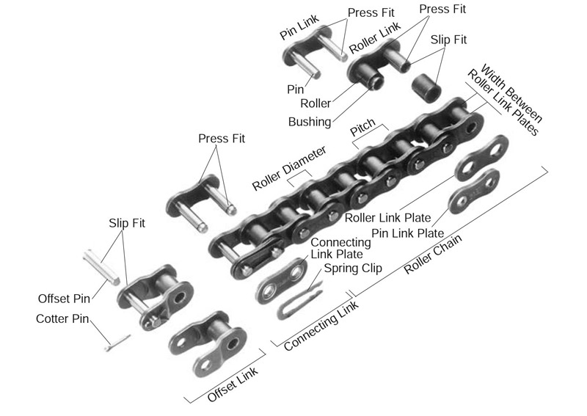

Slide 104
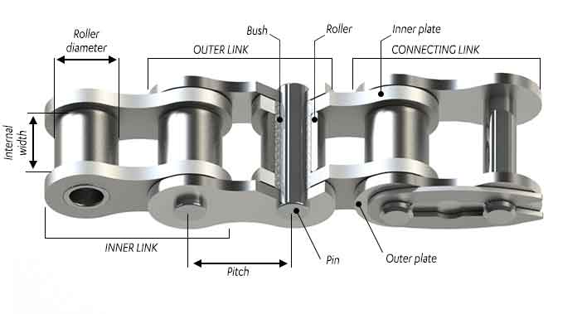

Slide 105
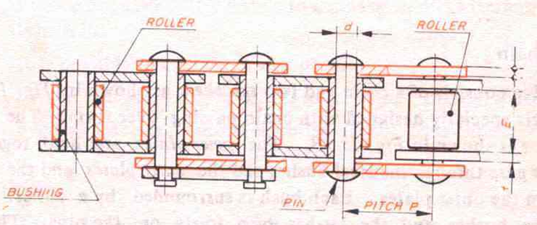

Slide 106
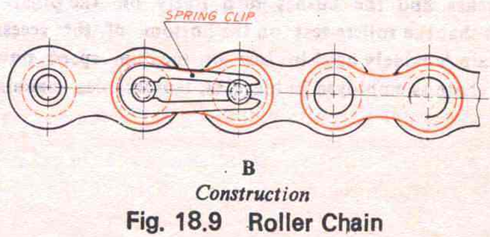

Slide 107
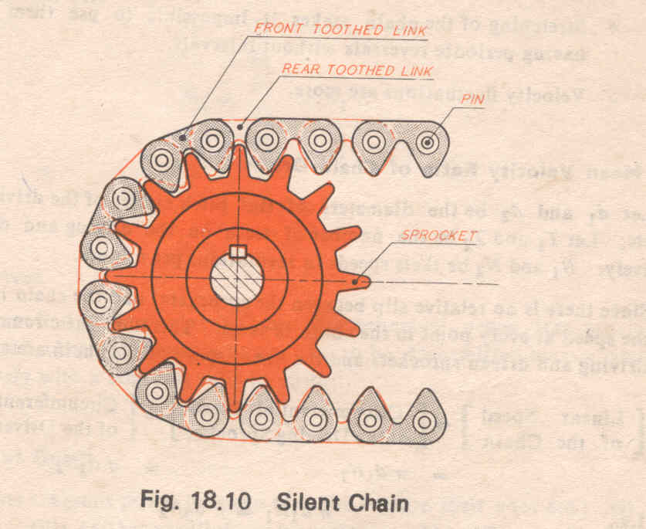
Silent Chain

Slide 108
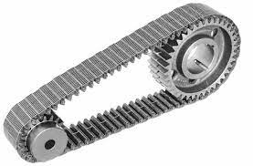
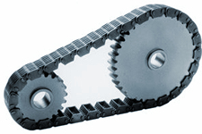
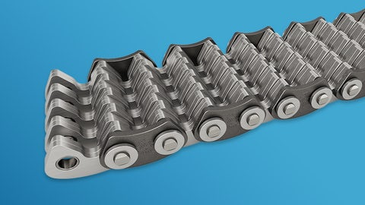

Slide 109
Chain Drive – Advantages
Positive non-slip drives
Efficiency is high
Employed for small as well as large centre distances up to 8m.
Permit high velocity ratio up to 8:1
Transmit more power than belt drives
They produce less load on shafts compared to belt drives
Maintenance is low

Slide 110
Chain Drive – Disadvantages
Driving and driven shafts should be in perfect alignment
Requires good lubrication
High initial cost

Slide 111
Rope Drive

Slide 112
Rope Drive
When centre distances are greater than 10 m
Power to be transmitted is more than 200 HP
Used in lifts, hoists etc

Slide 113
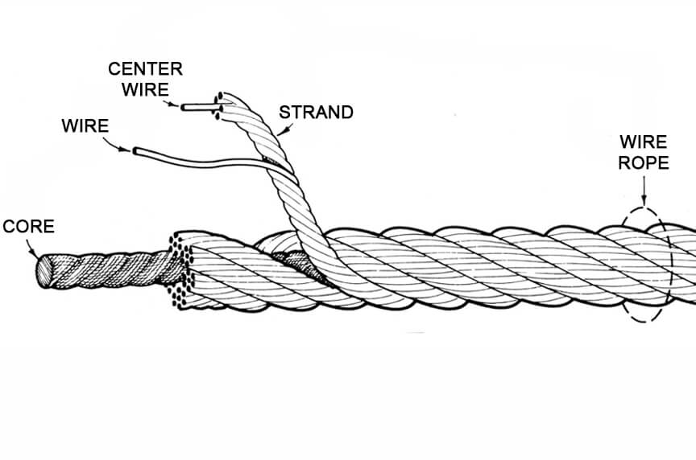

Slide 114
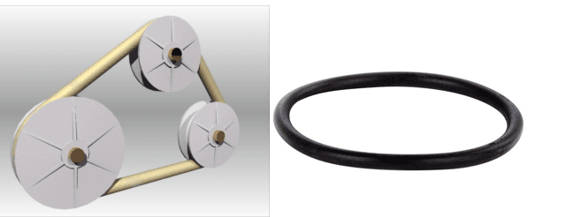

Slide 115
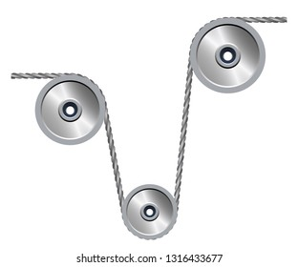
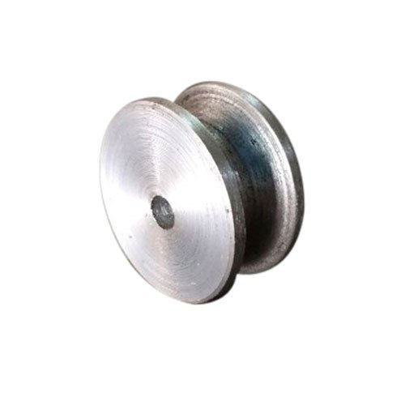

Slide 116
Gear Drives

Slide 117
Types of gears
The different types of gears used are:
1. Spur Gears - For Parallel Axes shafts.
2. Helical Gears - For both Parallel and Non-parallel
and non-intersecting axes shafts.
3. Spiral Gears - For Non-parallel and Non-intersecting axes shafts.
4. Bevel Gears - For Intersecting Axes shafts.
5. Worm Gears - For Non-Parallel and Non-co-planar axes shafts.
6. Rack and Pinion - For converting Rotary motion into linear motion.

Slide 118
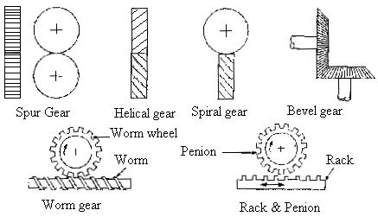
Types of gears

Slide 119


Slide 120

Spur Gears
Applications:
Machine tools
Automobile gear boxes
All general cases of power transmission where gear drives are preferred.

Slide 121

Spur Gear

Slide 122



Slide 123

Helical Gears
Teeth are cut in the form of the helix around the gear
Contact between the mating gears will be along a curvilinear path.
Preferred when smooth and quiet running at higher speeds are necessary.
Generally they are used in
automobile power transmission.

Slide 124


Helical Gear

Slide 125


Slide 126

Bevel gears
Used when the axes of the two shafts are inclined to one another, and intersect when produced.
Teeth are cut on the conical surfaces.
The most common examples of power transmission are those in which the axes of the two
shafts are at right angles to each other.
C

Slide 127

Bevel Gear

Slide 128


Slide 129

Spiral Gears
Used to connect only two non-parallel, non-intersecting shafts
There is a point contact
in spiral gears
Because of the point contact
the spiral gears are more suitable for transmitting less power.

Slide 130



Slide 131

Rack and Pinion
Used when a rotary motion is to be converted into a linear motion.
Rack is a rectangular bar with a series of straight teeth cut on it.
Small gears are called pinions.
Application:
Machine tools, such as, lathe,
drilling, planer machines

Slide 132


Rack and Pinion

Slide 133





Slide 134

Worm Gear
Special form of gearing in which teeth have a line contact
Axes of driving and driven shafts are at right angles
It is also called screw gearing
Used in machine tools like Lathe,
Drill, Milling to get large velocity ratio

Slide 135


Worm Gear

Slide 136


Slide 137



Slide 138
Velocity Ratio of a Gear Drive
The velocity ratio of a gear drive is defined as
the ratio of the speed of the driven gear to the
speed of the driving gear.

Slide 139


Slide 140
Expression for velocity ratio of a gear drive.
d₁ = pitch circle diameter of the driving gear in mm
d₂ = pitch circle diameter of the driven gear mm
T₁ = number of teeth on the driving gear
T₂ = number of teeth on the driven gear
N₁ =speed of the driving gear in rpm
N₂ = speed of the driven gear in rpm

Slide 141
Since there is no slip between the pitch cylinders of the two
gear wheels,
The linear speed of the two pitch cylinders must be equal.
=
The circular pitch for both the meshing gears remains same.

Slide 142
From equation (1) and (2)
Velocity Ratio of a Gear Drive =
=
=
Velocity ratio of the worm and worm wheel is expressed as:
Number of Teeth on Worm Wheel
Velocity ratio
=
Speed of the Worm
=
Speed of the Worm
Wheel
Number of Threads on the Worm

Slide 143
Gear Train:
A gear train is an arrangement of number of
successively meshing gear wheels through
which the power can be transmitted between
the driving and driven shafts.

Slide 144
The gear wheels used in gear train may be spur , bevel or helical etc.
Two main types of gear trains are:
Simple gear train.
Compound gear train.

Slide 145

Simple Gear Train

Slide 146


Slide 147


Slide 148

Simple Gear
Train
z
z
z

Slide 149
Simple gear train
In a simple gear train a series of
gear wheels are mounted on
different shafts between the
driving and driven shafts and
each shaft carries only one
gear.
A → Driving gear
B → Intermediate gear
C → Intermediate gear
D → Driven gear
Gear A
Gear B
Gear C
Gear D
Simple gear train

Slide 150
Velocity ratio of a simple gear train.
N_{A =} speed in RPM of gear A
N_{B =} speed in RPM of gear B
N_{C =} speed in RPM of gear C
N_{D} = speed in RPM of gear D
T_{A} = Number of teeth of gear A
T_{B} = Number of teeth of gear B
T_{C} = Number of teeth of gear C
T_{D} = Number of teeth of gear D
Gear A
Gear B
Gear C
Gear D
Simple gear train

Slide 151
A drives B
B drives C
C drives D
Gear A
=
Gear B
Gear C
=
Gear D
=
Simple gear train

Slide 152
Velocity ratio between the driving and driven gears is given by,
Gear A
Velocity Ratio =
Gear B
.
.
=
Gear C
Substituting from (i), (ii) and (iii)
.
.
Velocity Ratio =
.
.
Gear D
.
.
=
Simple gear train
Velocity Ratio
=

Slide 153
Compound gear train
A compound gear train is
one in which each shaft
carries two or more gears
which keyed to it, other
than driving and driven
shafts.
Gear B →Compound gear
Gear C →Compound gear
Gear A
Gear B
Gear C
Gear D
Compound gear train

Slide 154


Slide 155


Slide 156


Slide 157


Slide 158
Gear A drives B,
……….(1)
Gear A
Since gears B and C are keyed to the same shaft,
Gear B
Both of them rotate at the same speed
Gear C
Gear D
N_{B} = N_{c}
but T_{B} ≠T_{C}
Gear C drives D,
Compound gear train
………(2)

Slide 159
Velocity ratio between driving and driven gear
Gear A
.
=
Gear B
Gear C
Substituting from (1) and (2)
Gear D
Velocity ratio =
.
Compound gear train

Slide 160
Advantages of a Gear Drive
Advantages:
1. They are positive (non-slip) drives.
2. Most convenient for very small centre distances.
3. Transmit the power when the axes of the shafts are
parallel, non­parallel, intersecting, non-intersecting
4. The velocity ratio will remain constant throughout.

Slide 161
5. Employed for low, medium and high power transmission.
6. Any velocity ratio can be obtained.
7. They have very high transmission efficiency.
8. Gears are employed for wide range of applications

Slide 162
Disadvantages of a Gear Drive
1. They are not suitable for shafts of very large centre distances.
2. They always require some kind of lubrication.
3. At very high speeds noise and vibrations will be more.
4. They are not economical because of the increased cost of production of precision gears.
5. Use of large number of gear wheels in gear trains increases the weight of the machine.

Slide 163
Problems on belt drive

Slide 164
1) An electric motor provides 6 KW power to an open belt
drive. The diameter of the motor pulley is 200mm and it
rotates at 900 rpm. Calculate tight and slack side tension
in the belt if the ratio of tension is 2.
Solution:
P = 6kW
d₁ = 200 mm
n₁ = 900 rpm
= 2.

Slide 165
P = 6kW, d₁ = 200 mm, n₁ = 900 rpm ,
= 2.
Linear velocity of belt v =
=
= 9.425 m/sec
Power P =
∴ T₁ – T₂ =
=
= 636.6 N

Slide 166
By data,
= 2.
We get, 2T₂ – T₂ = 636.6N
∴ Slack side tension T₂ =
636.6 N
Tight side tension T₁= 2T₂ = 1273.2 N

Slide 167
2) A leather belt transmits 20kW power from a pulley of
750mm diameter which runs at 500 rpm. The belt is
in contact with the pulley over an arc of 160⁰ and
the coefficient of friction between the belt and the
pulley is 0.3. Find the tension on each side of the
open belt drive.
Solution:
P = 20 k W
d = 750 mm
n = 500 rpm
θ = 160⁰
μ = 0.3

Slide 168
Linear velocity of belt v =
=
= 19.635 m / sec
Power P =
T₁ – T₂ =
=
= 1018.6 N …………….(1)

Slide 169
By data,
= e ^{μθ}
………….(2)
From equations (1) and (2)
2.311 T₂ – T₂ = 1018.6
∴ Slack side tension T₂ = 776.96 N
Tight side tension T₁ = 776.96 (2.311) = 1795.6 N

Slide 170
3) Power is transmitted by an open belt drive from a
pulley 300 mm diameter running at 600rpm to a pulley
500 mm in diameter. The distance between the centre
lines of the shaft is 1m. and the coefficient of friction in
the belt drive is 0.25. If the safe pull in the belt is not to
exceed 500 N, determine the power transmitted by the
belt drive.
Solution:
d₁ = 300 mm.
T₁ = 500 N
n₁ = 600 rpm
μ = 0.25
d₂ = 500mm
c= 1m. = 1000 mm

Slide 171
Linear velocity of belt v =
=
Radius of driver pulley r₁ =
=
= 150 mm.
Radius of driven pulley r₂ =
=
= 250 mm.
Angle of lap on smaller pulley θ = π - 2 sin ⁻¹
(because r₂ – r₁)
θ = π - 2 sin ⁻¹
= 2.94 rad.

Slide 172
Ratio of tensions
= e^{μθ}
= e ^{(0.25 ) . (2.94)} = 2.085
∴ Slack side tension T₂ =
= 239.8 N
Power P =
P =
P = 2.425 kW

Slide 173
4) A shaft running at 160 rpm is to drive another shaft at 250 rpm and transmit 20 kw.The coefficient of friction between the belt and the pulley is 0.25. The diameter of the smaller pulley is 0.6m and the distance between the shaft centers is 2.75m.Determine the length of belt, tight side and slack side tension in i) Open belt and ii)cross belt connecting the two pulleys.

Slide 174
Gear Drive Problems

Slide 175
1) A gear wheel has 50 teeth of module 5mm. Find the pitch
circle diameter and the circular pitch.
Given:
module, m= 5mm
T= 50
P_{c}=?
d =?
Solution:
Module m = d
T
5 = d
50
d=250 mm

Slide 176
Circular pitch, P_{c}= Πd
T
P_{c}= Π∗250
50
P_{c}=15.7 mm

Slide 177
2) Two gear wheels having 80 teeth and 30 teeth mesh
with each other. If the smaller gear wheel runs at 480
rpm, find the speed of the larger wheel.
Given:
Larger Gear wheel Smaller Gear Wheel
T₁= 80 T₂= 30
N₁=? N₂=480 rpm

Slide 178
Solution:
Velocity ratio of a gear drive,
N₂
T₁
=
N₁
T₂
T₂
N₁
=
X
N₂
T₁
30
=
X
480
80
= 180 rpm

Slide 179
3) A gear wheel of 20 teeth drives another gear wheel having 36 teeth running at 200 rpm. Find the speed of the driving wheel and the velocity ratio.
Given:
Driving wheel Driven Wheel
T₁= 20 T₂= 36
N₁=? N₂=200 rpm
velocity Ratio = ?

Slide 180
Solution:
N₂
T₁
=
N₁
T₂
T₂
N₁
=
X
N₂
T₁
= 360 rpm
N₂
Velocity Ratio =
N₁
= 1:1.8

Slide 181
4) In a simple train of gears, A has 30 teeth, B has 40
teeth, C has 60 teeth and D has 40 teeth. If A makes
36 rpm, find the rpm of the gear C and D.
Given:
T_{A}= 30, T_{B}= 40, T_{C}= 60, T_{D}= 40, N_{A}=36 rpm
N_{C}=? N_{D}=?

Slide 182
Given:
T_{A}= 30, T_{B}= 40, T_{C}= 60, T_{D}= 40, N_{A}=36 rpm
N_{C}=? N_{D}=?
Solution:
N_{C}
T_{A}
T_{A}
=
N_{C}
N_{A}
= 18 rpm
=
X
N_{A}
T_{C}
T_{C}
N_{D}
T_{A}
=
T_{A}
N_{D}
=
X
N_{A}
= 27 rpm
N_{A}
T_{D}
T_{D}

Slide 183
5) A compound gear consists of 4 gears A,B,C and D and they have 20, 30, 40 and 60 teeth respectively. A
is fitted on the driver shaft, and D is fitted on the driven
shaft , B and C are compound gears, B meshes with A, and C meshes with D. If A rotates at 180 rpm, find the rpm of D.

Slide 184
Given:
T_{A}= 20, T_{B}= 30, T_{C}= 40, T_{D}= 60, N_{A}=180 rpm
N_{D}=?
N_{D}
T_{C}
T_{A}
=
X
N_{A}
T_{D}
T_{B}
N_{D}
T_{C}
T_{A}
=
X
X
N_{A}
T_{D}
T_{B}
= 80 rpm

Slide 185
6) A compound gear train consists of 6 gears A,B,C,D,E and F, they have 20, 30, 40, 50, 60, 70 teeth respectively. A is fitted to the first shaft and meshed with B. B and C are fitted to the second shaft and C is meshed with D. D and E are fitted to the third shaft and E is meshed with F which is fixed to another shaft.

Slide 186
Given:
T_{A}= 20, T_{B}= 30, T_{C}= 40, T_{D}= 50, T_{E}=60, T_{F}=70,
N_{A}=210 rpm
N_{F}=?
Gear F
Gear B,C
Gear A
v
c
Gear D,E
Compound train of wheels

Slide 187
Given:
T_{A}= 20, T_{B}= 30, T_{C}= 40, T_{D}= 50, T_{E}=60, T_{F}=70,
N_{A}=210 rpm
N_{F}=?
v
c
Solution:
.
.
.
.
= 96 rpm
N_{F}

Slide 188
7) A compound gear train is formed by 4 gears P,Q,R and S.
Gear P meshes with gear Q and gear R meshes with
gear S. Gears Q and R are compounded. P is connected
to driving shaft and S connected to the driven shaft and
power is transmitted. The details of the gear are,
Gears | P | Q | R | S
No. of Teeth | 30 | 60 | 40 | 80
If the gear S were to rotate at 60 rpm. Calculate the speed of P. Represent the gear arrangement schematically.

Slide 189
SOLUTION:
Velocity ratio =
.
Gear P,T_{P}=30
.
=
Gear Q,T_{Q}=60
Gear R,T_{R}=40
Speed of P, N_{P} = 240 rpm
Gear S,T_{S}=80
Gear arrangement

Slide 190
8) Two parallel shafts are to be connected by a gear
drive. They are very nearly 1m apart and their velocity
ratio is to be exactly 9:2. If the pitch of the gears is 57
mm, find the number of teeth in each of the two
wheels and distance between the shafts.

Slide 191
Let d₁ and d₂ be the pitch diameter of the 2 gears
d₁+d₂
Distance between the gears =
= 1m
…….1
2
Given
N₂
d₁
9
=
=
N₁
d₂
2
9
d₁
=
d₂
…….2
2
d₂=363.6 mm
d₁=1636 mm

Slide 192
d₁=1636 mm
d₂=363.6 mm
Circular pitch, P_{c}= Πd₁
T₁
=
Πd₂
=57 mm
T₂
T₁
=
Πd₁
=90.18
57
T₂
=
Πd₂
=20.04
57
Take T₁ and T₂ as 90 and 20 respectively.
d₁=
P_{c}T₁
=1633 mm
Π
d₂=
P_{c}T₂
=363 mm
Π
d₁+d₂
Exact centre distance =
2
=998 mm = 0.998m

Slide 193
9) A gear train consists of six gears A,B,C,D,E,F and
they contain 20,30,40,50,80,100 teeth respectively.
Show the arrangement of the gears to obtain
Maximum velocity ratio
Speed reduction of 6.
D
C
A
v
c
E
F
B
N

Slide 194
Solution:
Maximum velocity ratio
Given:
A= 20
B= 30
C= 40
D= 50
E= 80
F= 100
= 16.66
D
F
A
v
c
B
C
E

Slide 195
Speed reduction of 6.
Given:
A= 20
B= 30
C= 40
D= 50
E= 80
F= 100
Driven
F
C
Driver
v
c
A
D
B
E
= 1/6

Slide 196
10)Five spur gears of 20,30,50 and 120 teeth are available along with 3 helical gears of 30, 60 and 80 teeth of all having same diametral pitch. Show the arrangement of gears to get maximum possible velocity ratio using maximum numbers of wheels from the above set of gears.

Slide 197
Given: S₁= 20 H₁= 30
S₂= 30 H₂= 60
S₃= 50 H₃= 80
S₄= 80
S₅= 120
Maximum possible velocity ratio = ?
= 42.6

Slide 198
11) There are 5 wheels having 20, 40, 60, 80 and 100 teeth with a diametral pitch of 3 and another set of 4 wheels of diametral pitch of 2 having 20, 40, 60 and 70 teeth. Sketch an arrangement to get maximum velocity ratio using maximum number of wheels from the above lot. Also mention the conditions used.

Slide 199
= 52.5
Maximum number of wheels used = 8
Conditions:
Select the driving gear with maximum number of teeth &
driven gear with minimum number of teeth
Mesh two gears with same diametral pitch

